Slide 1


Living the dream at SUPINFOHBIBI
Double Semaine Intensive
Supinfogame 27-02-17 - 10-03-1

Slide 2
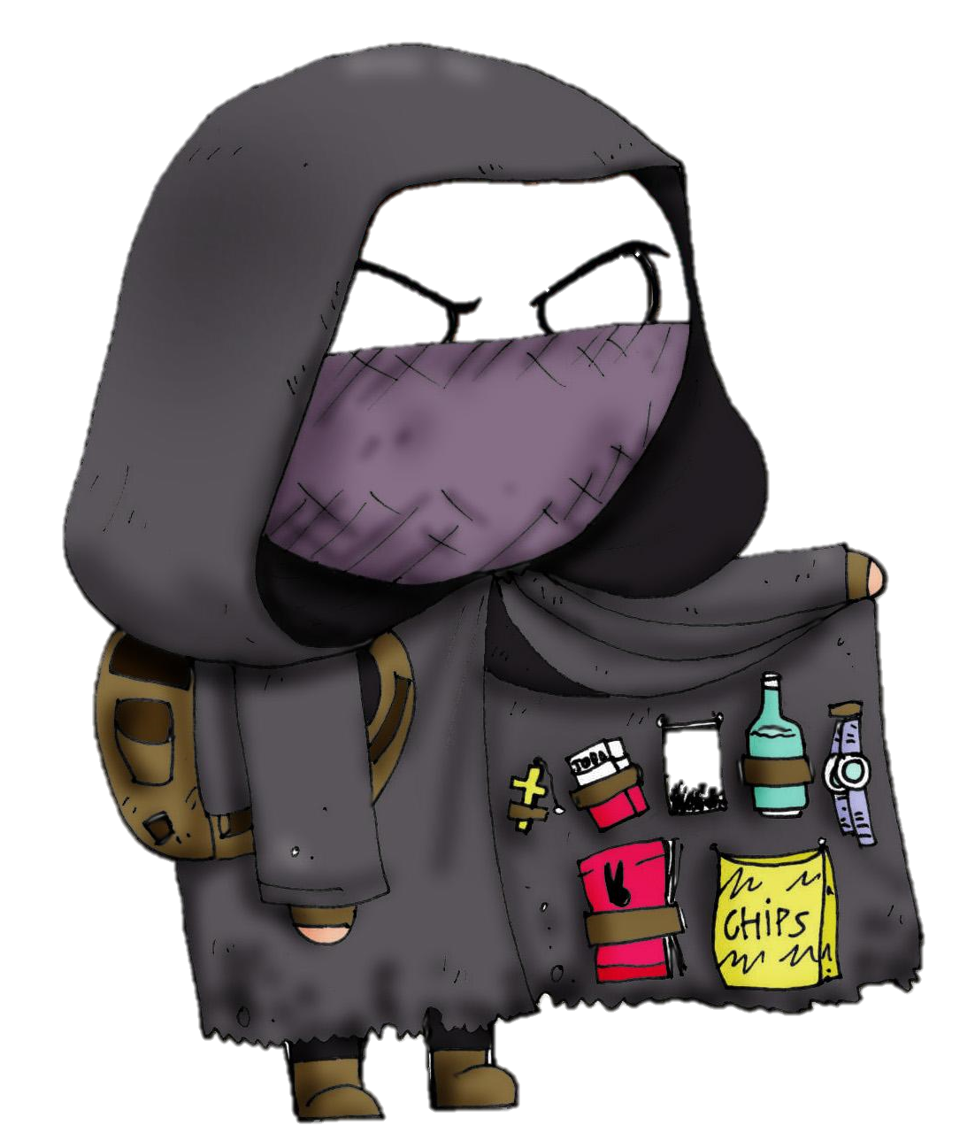

Over here, stranger!
I’m Martial

Slide 3

Notes:
Grosse présentation, prends 5-10 minutes

Slide 4


Slide 5


Hey, listen!
I’m Flo

Slide 6
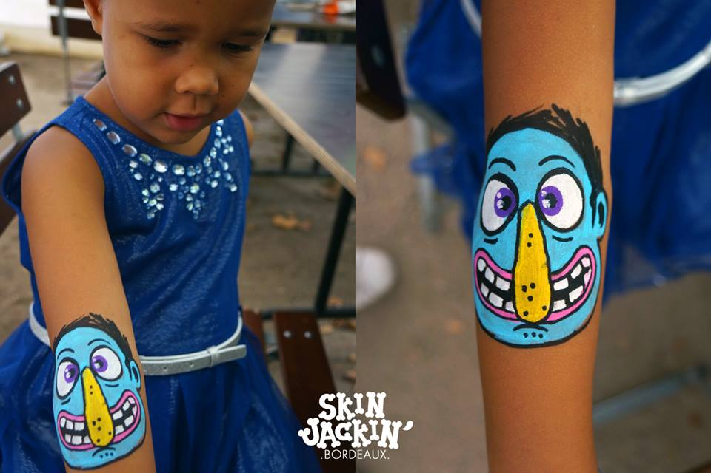

Slide 7
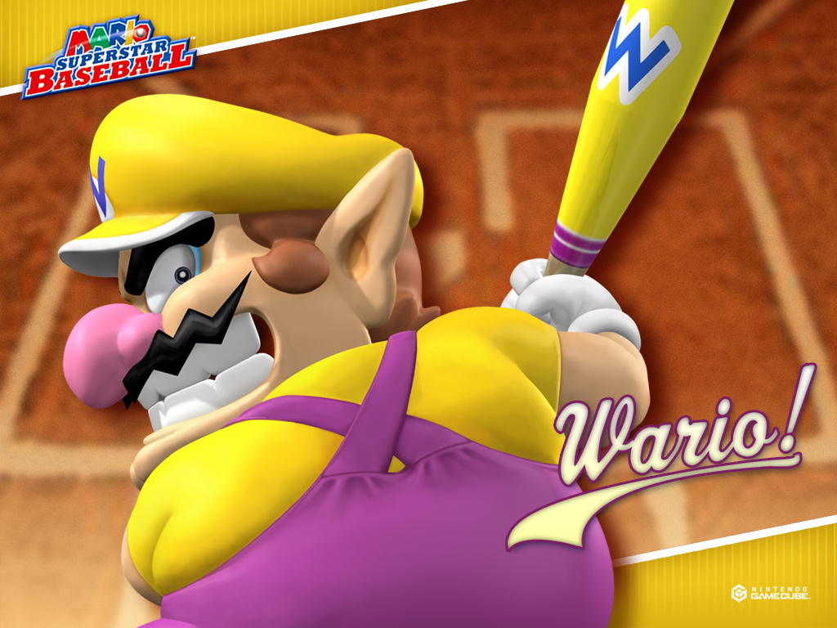

Slide 8
Booo!
I’m Arnaud

Slide 9


+

Slide 16
?

Slide 17

SUPINFOHBIBI

Slide 18
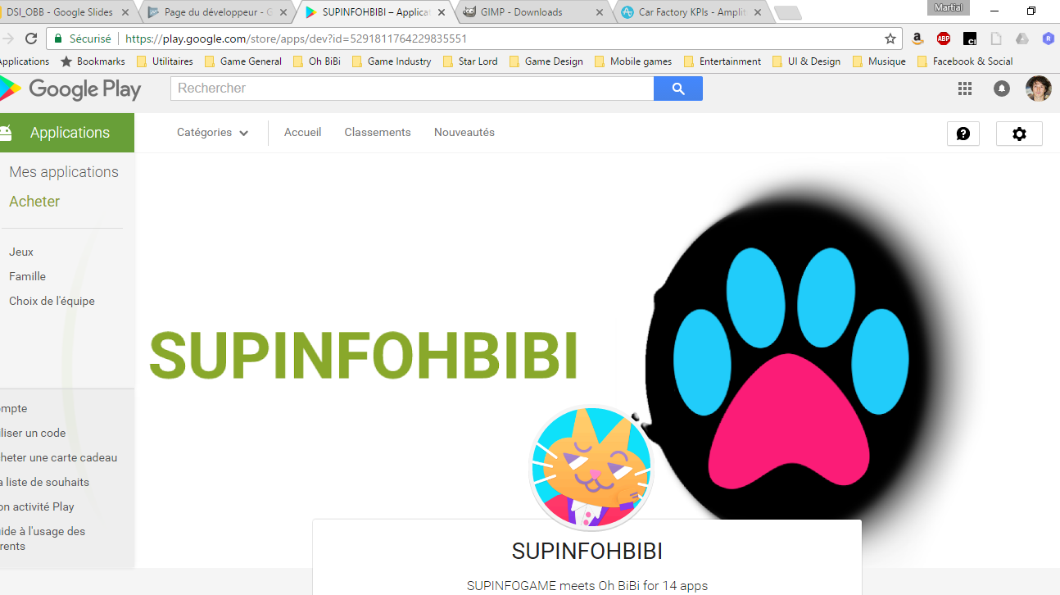

Slide 19
Oh BiBi Overview
20 people
Mobile games as a service
3 live games
3 games in production or soft launch
11 million players - $9 million revenue

Slide 20


Slide 21


Slide 22


Slide 23


Slide 24


Slide 25

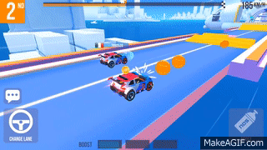

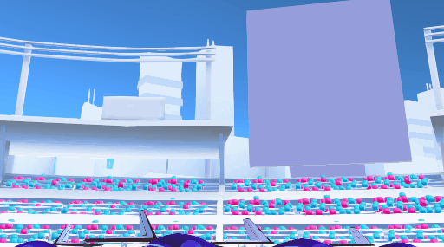

Slide 26


Slide 27
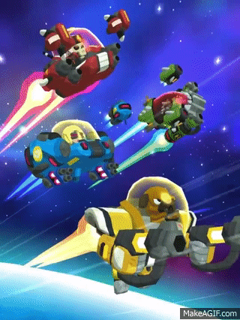
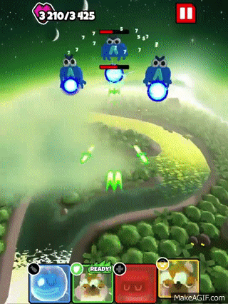
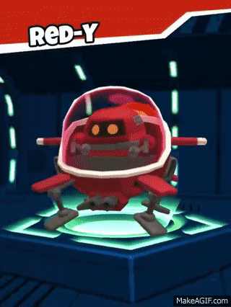

Slide 28
DSI Objectives
Ship a real game

Slide 29


Slide 30
DSI Objectives
Ship a real game
Have real people play it
Bring real improvements
Be real proud of the results

Slide 31
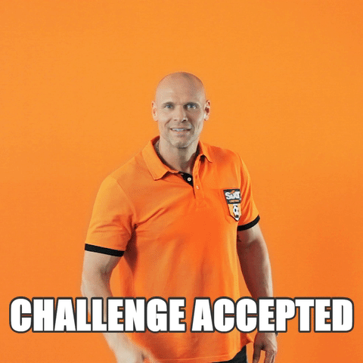

Slide 32
DSI Process
Design
Development
Publishing
Promotion
Playtest & analysis
Iteration
Grading

Slide 33
Design rules
Full game (this is not a proto)
Free game (no monetization)
Replayabality (can be played +10 hours)
Scoring (competitive aspect)
Portrait (playable with one hand)

Slide 34


Slide 35
Development rules
1st week: design & production
2nd week: iteration & optimization
Keep it simple
Unity C#
Playable on mobile and on PC
APK < 100mb (downloadable over 3G)
At least 5 events on Amplitude

Slide 36
Publishing rules
Publish your APK in Beta
Select Open Testing (“Early Access”)
Keep everything tasteful

Slide 37


Slide 38
Promotion rules
Create appealing assets (icons - screenshots)
Write a cool description (French + English)
Promote your app through every possible mean: schoolmates, friends, Twitter, influencers, your mum!

Slide 39


Slide 40
Analysis Rule
Implement meaningful events and see where your game is working (and where it’s not)
Compare your app’s performance to industry’s benchmark
Send a survey to your playtesters to better understand your players

Slide 41
Data Point Structure
RaceEnded
Player Position
Total Interactions
Positive & Negative Changes
Opponents’ positions, times, car models, etc.

Slide 42
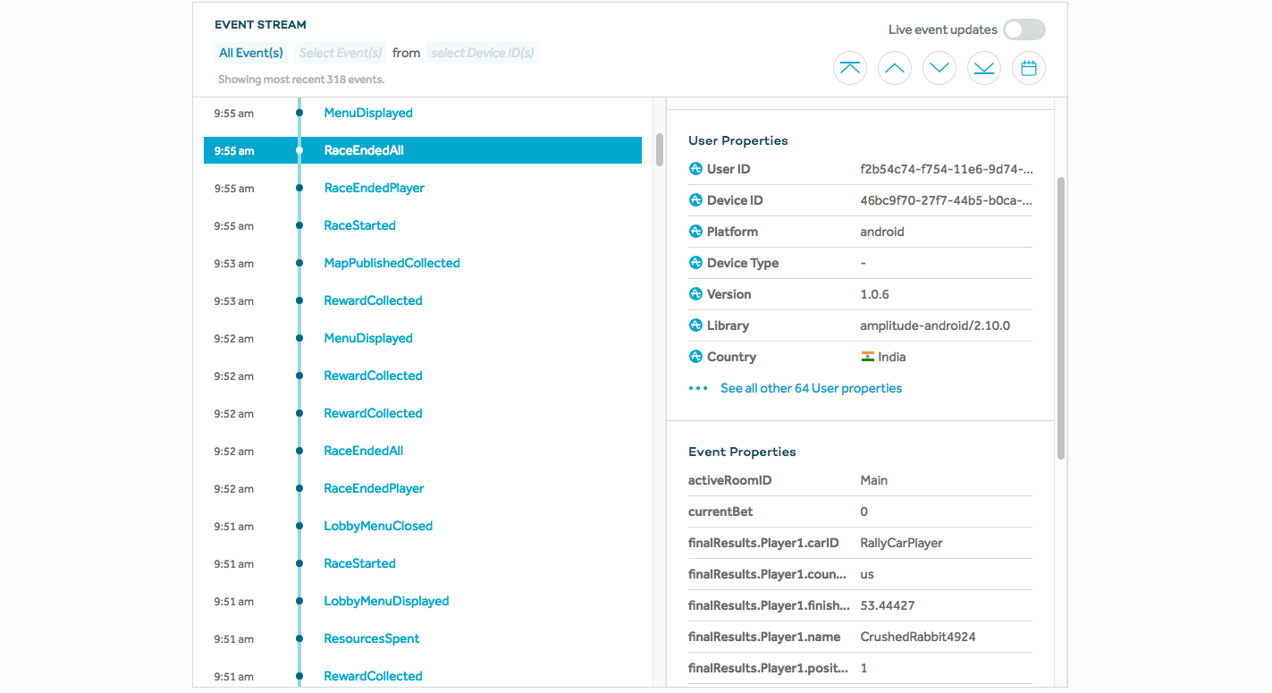

Slide 43
Iteration Rule
Don’t feature creep
Make what’s good, better
Set objectives, develop actions and analyze results

Slide 44
Data Point Results
Car Win Ratio
Car Players’ Preference
Global Economy Balancing
Bugs & Cheaters
Player Progression
Level Design Stress Test
Best Race Length
Features Utilization Ratio

Slide 45
Data-informed design
How the start position impacts the result of a race?
What is the optimal energy cost?
What is the ideal first session?

Slide 46


Slide 47
Grading system
Install numbers
Metrics (retention, sessions length & nb, progression)
User comments
Respect of initial rules
Game quality (design, gfx, polish)

Slide 48
Oh BiBi provides
Unity project type (including analytics)
Tutorials
Tool access
Email support : supinfogame.dsi@ohbibi.com

Slide 49

Any questions?
supinfogame.dsi@ohbibi.com

